Slide 1


Advanced SQL for DQE
Part 1
Authors: Christina Begoun, Yevhen Nikolin
Date: 06-Apr-2020

Slide 2
AGENDA
GROUP BY ROLLUP ()| CUBE () | GROUPING () | GROUPING ID ()
SELECT – OVER Clause
Recursive queries
String functions

Slide 3
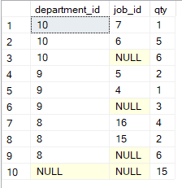
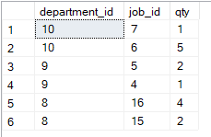
ROLLUP
The ROLLUP operator is used with the GROUP BY clause. It allows you to include extra rows that represents the subtotals and grand totals for a set of columns. The summarized amounts are created based on the columns passed to the ROLLUP operator.
SELECT
[department_id], [job_id], COUNT(*) [qty]
FROM [hr].[employees]
WHERE [department_id] IN (8, 9, 10)
GROUP BY [department_id], [job_id]
ORDER BY [department_id] DESC, [job_id] DESC;
SELECT
[department_id], [job_id], COUNT(*) [qty]
FROM [hr].[employees]
WHERE [department_id] IN (8, 9, 10)
GROUP BY ROLLUP ([department_id], [job_id])
ORDER BY [department_id] DESC, [job_id] DESC;

Slide 4
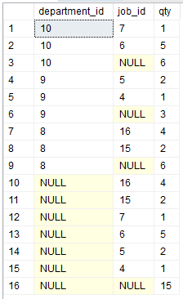
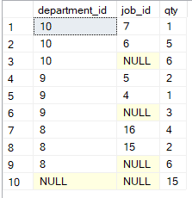
CUBE
The CUBE operator is also used in combination with the GROUP BY clause. CUBE produces subtotals by generating all combinations of columns specified in the GROUP BY CUBE clause. For GROUP BY CUBE (a, b) the results has groups for unique values of (a, b), (NULL, b), (a, NULL), and (NULL, NULL).
GROUP BY
ROLLUP ([department_id], [job_id]):
GROUP BY
CUBE
([department_id], [job_id]):

Slide 5
GROUPING and GROUPING ID
GROUPING function is used to identify whether the columns in the GROUP BY list are aggregated (using the ROLLUP or CUBE operators) or not. GROUPING_ID is a function that computes the level of grouping.
There are three major differences between the GROUPING and GROUPING_ID Functions.
The GROUPING function is applicable on a single column, whereas the column list for the GROUPING_ID function has to match the column list in the GROUP BY clause.
The GROUPING function indicates whether a column in the GROUP BY list is aggregated or not. It returns 1 if the result set is aggregated, and 0 if the result set is not aggregated.
GROUPING_ID function also returns an integer. However, it performs the binary to decimal conversion after concatenating the outcome of all the GROUPING functions.
GROUPING and GROUPING_ID can be used only in the SELECT, HAVING or ORDER BY clauses when GROUP BY is specified.

Slide 6
SELECT – OVER Clause
Types functions that are used with OVER Clause in MS SQL Server:
Aggregate functions:
Ranking functions:
RANK(), DENSE_RANK(), ROW_NUMBER(), NTILE()
Analytic functions:
NEXT VALUE FOR function
APPROX_COUNT_DISTINCT | MIN
AVG | STDEV
CHECKSUM_AGG | STDEVP
COUNT | VARP
COUNT_BIG | SUM
MAX | VAR
CUME_DIST | LEAD
FIRST_VALUE | PERCENTILE_COUNT
LAG | PERSENTILE_DISC
LAST_VALUE | PERSENT_RANK
More information about the listed functions can be found here.

Slide 7
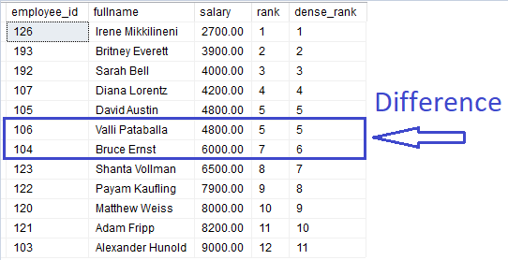
RANKING FUNCTIONS
RANK | NTILE
DENSE_RANK | ROW_NUMBER
RANK() function is used to give a unique rank to each record based on a specified value, for example salary. If two records have the same value, then RANK() function will assign the same rank to both records by skipping the next rank.
DENSE_RANK() function is identical to the RANK() function except that it does not skip any rank. This means that if two identical records are found then DENSE_RANK() will assign the same rank to both records but will not skip the next rank.

Slide 8
RECURSIVE QUERIES
A recursive common table expression (CTE) is a CTE that references itself. By doing so, the CTE repeatedly executes, returns subsets of data, until it returns the complete result set.
In general, a recursive CTE has three parts:
An initial query that returns the base result set of the CTE. The initial query is called an anchor member;
A recursive query that references the common table expression, therefore, it is called the recursive member. The recursive member is union-ed with the anchor member using the UNION ALL operator;
A termination condition specified in the recursive member that terminates the execution of the recursive member.
More information can be found here.

Slide 9
RECURSIVE QUERIES
Task 1: build a parent-child management hierarchy for employees.
Task 2: generate a set of numbers with fixed length.
Task 3: get the sum of manager’s subordinates’ salaries (including the recursive ones).
Task 4: given a denormalized data in a string. Need to parse this string and make the values atomical.

Slide 10
STRING FUNCTIONS
LEN() is used to determine a string’s length:
Syntax: SELECT LEN('AdvancedSQL’);
Output: 11
CHARINDEX() searches for a substring in a string and returns the position:
Syntax: SELECT CHARINDEX('t', 'Customer’);
Output: 4
REPLACE() replaces all occurrences of a specified string value with another string value:
Syntax: REPLACE('123SQL123', '123', 'Advanced’);
Output: ‘AdvancedSQLAdvanced’
SUBSTRING() extracts a substring with a specified length starting from a location in a string:
Syntax: SELECT SUBSTRING('epam.com', 6, 2);
Output: ‘co’
STUFF() deletes a part of a string and then inserts another part into the string, starting at a specified position:
Syntax: SELECT STUFF('SQL Tutorial', 1, 3, ‘HTML’);
Output: ‘HTML Tutorial’
LEFT() returns the left part of a character string with the specified number of characters:
Syntax: SELECT LEFT('abcdefg',2);
Output: ‘ab’

